Slide 1
TAKING SOIL SAMPLES & MEASURING GROUND COVER
D M Crawford
Presentation to train farmers
26th April 2016, Bengworden, Clifton Creek

Slide 2
WHAT DO I WANT TO COVER TODAY?
Know how to take a soil sample
Align sampling with reason for testing, the soil tests and the farming system
Know how to measure ground cover
Importance of sampling soil and assessing ground cover

Slide 3
WHAT I WANT AT THE END OF TODAY?
Every one is on the same page
Understand why we are doing what we are doing
Know how to deliver a credible sample with correct documentation

Slide 4
CONTEXT
Notes:
Soil testing is part of a larger picture. The chemist is only involved on the laboratory analysis. The agronomist is involved in the recommendation step. The soil scientist ties these together. The adviser has to sufficiently understand the technical aspects of sampling, analysis, interpretation and agronomy to produce a recommendation. The farmer has to understand these also, albeit to a less detailed intensity, but sufficient for the farmer to now what good sampling and analysis looks like and so is able to make a useful decision.
It is important to distinguish between soil testing when investigating soil fertility (soil fertility, soil health and soil condition are synonymous in this instance), soil testing for getting an organic farming certificate and soil testing for regulation. The latter two have defined methods with unequivocal outcomes. In comparison to those used for testing soil fertility, these defined methods of sampling, analysis and interpretation are followed without deviation from the documented instructions. Testing to meet regulation or certification rules are not considered any further.

Slide 5
The guts of it
Consistent sampling: 30 cores, 0-10 cm depth, zig zag across the paddock excluding unusual areas
Document details on who, when, how and where the sample was taken
Ground cover assessment documented
GPS/map the sampled area
Notes:
Within a paddock, sample the main area of land that has consistent soil type, landform and plant growth
Exclude obviously unusual areas (may or may not have the same results depending on test, soil processes, landform, management, animal behaviour, etc.)

Slide 6
Foundation concept
Environmental response
No environmental response
Environmental variable
Soil test
Management action
Notes:
A soil test must be able to indicate whether or not a management action will have an environmental effect. Otherwise it is useless. Soil testing can be of any kind ranging from laboratory analysis of a sample taken from the paddock, to visual assessment of the paddock or soil.

Slide 7
Why test soil?
How much fertiliser? (tactical management decisions, assess fertility when unknown)
Monitor changes (long term changes)
Problem solving (diagnosis)
Notes:
Questions usually resolve themselves into one of the above. Each of these demand different testing strategies. The sampling strategy and the choice of tests are then dictated by the testing hypothesis. Here we are sampling to assess the unknown fertility in a paddock that has either never been tested or tested so long ago as to need retesting, to achieve good ground cover whether as pasture (native or introduced) or crop. We are using an external reference for interpreting the tests. In contrast, testing as part of a monitoring program, and or testing to solve a problem, has internal references.

Slide 8
How much fertiliser?
Soil test is calibrated to predict the response to an input (external reference)
Sampling method (when, core size and core depth)
Choice of soil tests
Farming system
Notes:
Must match sampling, test, agronomic practises and growth conditions, (e.g. sampling, fertiliser, species, soil), between the tested paddock and the original research.
Most of the research on calibrating soil tests has focussed on P and most has been on P response in wheat and pastures. There has been less effort on N and K, and even less on the other nutrients, e.g. copper, and phytotoxins, e.g. aluminium. The audience needs to be made aware of the restrictions this places on the universal use of soil testing.

Slide 9
Monitoring
Strictly controlled sampling and testing:
Same paddock or site(s) within a paddock
Same sample
Same seasonal conditions
Same test
Inputs and outputs are the only variables
Notes:
Use calibrated soil tests and their sampling protocols for monitoring programs, as this allows comparison with soil test calibrations in addition to knowingly using soil tests which have a relationship to the known impacts of a management action on the environment.
In the past this method involves using physical marks to delineate the monitoring site. Now we can use GPS to mark out each monitoring site. However, the selection of an area of land as a monitoring site would still be based on prior knowledge, especially pasture condition, yield maps or EM maps. Practical reasons could also be preferably at soil moisture monitoring location.

Slide 10
HOW FREQUENTLY SHOULD SOIL BE TESTED FOR NUTRIENT ANALYSIS?
For dynamic tests such as P and N: at least every 3 to 5 years
For slow changing tests such as pH or SOC: every 10 years
Rotate testing around the paddocks of a farm
High intensity farming systems need more testing than low intensity farming systems

Slide 11
PROBLEM SOLVING
Investigate poor performance by comparing areas which are poor to those which are good
Diagnose problem with a calibrated soil test, e.g. test soil pH to see if poor barley yields are due to soil acidity
Same sampling protocol in both sampled areas on the same day
Notes:
Here an internal benchmark (the good area) is used for checking the target (the bad area). Yield maps and EM maps have advanced this type of investigation. This still requires a relationship between soil test, management action and environmental response. Therefore, use calibrated soil tests.
Problem solving needs some idea of what the problem may be. It requires interrogation of the manager, analysis of the paddock history and an understanding of the landscape and soils. Soil testing would only be used after eliminating potential causes of problems such as waterlogging, compaction, disease, pests, that are not going to be detected by soil testing.
Using calibrated tests in problem solving assumes that the available tests will detect the cause of the problem by direct analysis or inference from a related soil characteristic rather than reflect the symptoms. For example, direct measurement of aluminium or inference from measuring soil pH will identify the stunted lucerne roots are not the result of waterlogging, nematode attack, etc.
Soil testing and plant analysis complement each other in problem solving, as plant testing cannot be used to directly assess soil pH or salinity, while plant analysis enables a broader range of nutrients to be assessed.

Slide 12
PROBLEM SOLVING
Good
Poor
Investigate by comparing
Notes:
An investigation hypothesis of problem solving, would be to look at the roots and soil in the hole you have dug in the poor are, rather than by testing the soil in the area of poor growth as discussions of paddock history would find that waterlogging is suspected to be causing poor growth. This illustrates that problem solving starts with a broad open mind which then focuses on the likely cause or causes.

Slide 13
Mechanics of soil sampling

Slide 14
WHEN TO SAMPLE?
Generally summer and autumn: most research used to calibrate soil tests, was based on sampling soils in summer or autumn
TopSoil project has sampled in Autumn

Slide 15
WHERE and WHEN NOT TO SAMPLE!
Unusual areas e.g. stock camps, fence lines, headlands, table drains, poorly drained areas.
Areas limed within 3 months or fertilized within 2 months
Unusual soil conditions e.g. waterlogged
Unless you want to know what changes occur if you sample under these conditions
Notes:
Getting close to the true (but unknown) value, i.e. accuracy, most of the time (degree of confidence) is balanced against natural variability after eliminating the effects of obvious trends and the objective of the investigation hypothesis.

Slide 16
HOW MANY CORES ARE ENOUGH?
NUMBER OF CORES* | SOIL PARAMETERS
5 - 10 | Total N and organic C
10 - 20 | Above plus, pH, Al (not limed), EC (low salinity), exchangeable cations (no amendments applied)
20 - 30 | Above plus,extractable P, K, S (virgin sites or no fertiliser applied for many years)
30 - 40 | Suitable for all tests except where fertiliser or a soil amendment recently applied, fertiliser banded or high stocking rate.
40 - 60 | Suitable for all test (most situations)
>60 | Generally no significant gain in precision
* Surface samples
(Adapted from Peverill et al. 1999)
sub-surface : min. 8 – 10
Notes:
This is from Austin Brown's table in Peverill et al. 1999. Point out that subsoils are more variable than surface soil such that the recommended number is a compromise between effort, reward and the soil test variability (subsoil samples are usually taken for pH and EC not for nutrient deficiency investigations).

Slide 17
WHERE TO TAKE THE CORES
Zig-zag in a grid
Easy to do
Gives you an even coverage
Easy to count
Easy to vary for odd shapes
Notes:
Random patterns are desired according to classical statistics but geostatistics suggests a grid pattern is the most efficient. Given that there is usually no prior knowledge of the fertility trends in paddocks, other than those inferred from obvious differences in colour, texture, topography, paddock history and plant performance, a grid pattern is recommended. It will also be more practical in achieving an even coverage of a paddock than a random pattern. A grid pattern will also facilitate remember how many cores have been taken. Obviously, any available information should be used to modify the grid pattern to exclude unusual or non-target areas.
It is not enough to simply walk through the gate and get a spade-full of soil to put into the sample bag.

Slide 18
HOW MANY SAMPLES, HOW MANY CORES?
Uniform Paddock
How many?
Notes:
This and the following five slides can be used to illustrate how to deal with spatial trends in paddocks. The title asks the question how many bags of soil come out of the paddock with how many cores in each bag.

Slide 19
HOW MANY AND WHERE?
Head ditch
Uniform Paddock
How many?

Slide 20
HOW MANY SAMPLES, HOW MANY CORES? WHERE?
Top of hill
Loamy clay
Heavy clay
Variable Paddock
How many?

Slide 21
HOW MANY SAMPLES, HOW MANY CORES? WHERE
Strip A
Strip B
Sandy loam
Sandy loam
Grazed oats
Canola
How many?

Slide 22
HOW MANY SAMPLES, HOW MANY CORES? WHERE?
Deep sand
Sandy loam
Recently cleared
Loam
Variable Paddock
How many?
Notes:
This slide can by used in place of the previous slides.
Emphasise how the size of the paddock and the enterprise can influence the answer to the questions in the heading. Also discuss the reality of the ability of the farmer to alter management, for example change sowing or fertiliser rates, to suit the variations across this example paddock.
This discussion could be supplemented with aerial photographs of local paddocks.

Slide 23
Effect of Sampling Depth on Olsen P (mg/kg)
29
2
7.5
15
10
Depth cm
4
30
Too shallow
Too deep
(source: A Brown, DPI)
Notes:
Use to show what happens when a core is taken using the standard depth. Discuss how mixing of soils in cultivated land may lessen this sin to the point that it may not make much difference. Also, point out that when soil tests were calibrated, plough pans were ignored. Try not to sample fluffy cultivated soil. If this cannot be avoided, fluffy cultivated soils should be pressed down with the foot, first.

Slide 24
DEPTHS FOR CALIBRATED SOIL TESTS FOR PASTURES AND FIELD CROPS
Situation | Depth
Surface soil for Olsen P, Colwell P and Total N in crops and pastures | 0-10 cm
Deep N for crops | 0-60 cm
(Adapted from Peverill et al. 1999)

Slide 25
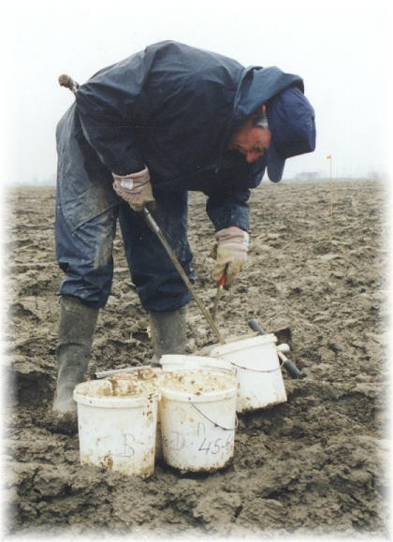
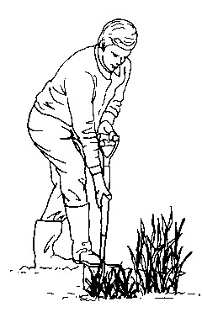
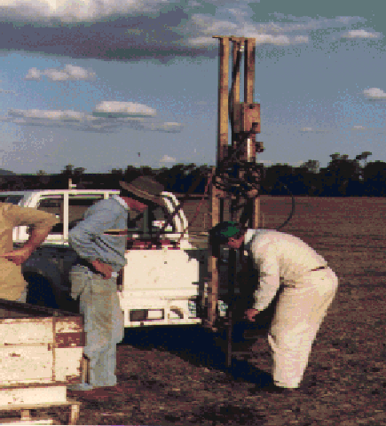
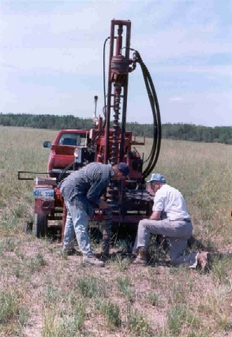
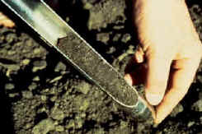
SAMPLING TOOLS
Notes:
Having discussed sampling depth, we can now look at practicalities of how you get the surface and sub-surface samples with the tools available.
Need to point out that augers pull more surface soil than subsurface soil, from the hole. This is a big problem where strong concentration gradients develop in soils, e.g. broadcast fertilisers on permanent pastures or where the soil has not been cultivated.
Take parallel sided in-tact cores with a spade or, preferably, a corer.

Slide 26
Other tools
GPS (download it as soon as you get home)
Field sheet (photo-copy it as soon as you get home)
Bucket
Screw-driver
Pen or Pencil

Slide 27
SAMPLE HYGIENE
Sampling equipment
Bags, buckets, bins and the ute
Hands
Most common problems :
Dust on utes, sample bags, hands and tools
SOC %, trace elements, lime, gypsum & fertiliser
Notes:
The ute is not for storing soil samples. Don’t store samples in the cabin of a ute or tractor. Don’t leave samples in a plastic bag in the sun. Be aware that couriers do not necessarily prevent samples being left in the sun.

Slide 28
SAMPLE STORAGE
In field - esky with cooler bricks
Short term ( 24 - 48 hours) - cool to about 4°C
Long term (48 hours - months) - dry
- freeze
Notes:
The ute is not for storing soil samples. Don’t store samples in a ute or tractor cabin. Don’t leave samples in a plastic bag in the sun. Be aware that couriers do not necessarily prevent samples being left in the sun.

Slide 29
Sample Transport
Deliver it yourself or by reliable courier or mail
Sample delivery to lab in 48 hours preferred
Time dispatch so that the samples are not in transit over weekends or holidays

Slide 30
Quarantine
Don’t send nasties
Quarantine
Notes:
Some states and countries, and even specified areas within some states, have strict quarantine requirements for soil or plant samples. This can mean that samples must be sterilised before they cross an international or state border, or the boundary of a quarantined area. This can also mean that the samples cannot be sent from the farm to the laboratory. Quarantine requirements change from time to time.
Importantly, the kind of treatments specified by quarantine regulations can alter the alter the test results. For example, samples may need to be dried, steamed, baked, irradiated or poisoned.
Check quarantine regulations before you take the sample.

Slide 31
Exercise

Slide 32
Bengworden

Slide 33
Bendoc

Slide 34
Wallagaraugh

Slide 35
CLOSE

