Slide 1
East Gippsland Topsoils Project Summary
Bendoc 8 March 2017

Slide 2
This project was initiated by the Department of Economic Development, Jobs, Transport and Resources (DEDJTR).
It has been developed in collaboration with East Gippsland CMA, Southern Farming Systems, Greening Australia, East Gippsland Landcare Network, Far East Victoria Landcare and Snowy River Interstate Landcare.
It has been funded by the Australian Governments National Landcare Program and the Victorian Governments Land Health Program.

Slide 3
Why create a soils and plant tissue database?
If you can’t measure it you can’t change it. Do the programs work?
Science around soils and plant tissue is established, that is, it is measurable and repeatable.
Identify spatial variation - Target resources to get the most change.
Future value: establish baseline conditions to determine rate of change overtime. (Temporal variation).

Slide 4
Soil and plant sampling by soil type

Slide 5
Region Wide
Erosion (sheet, rill, gully and tunnel) was observed on 18 of 75 sites (or 24% of sites) across East Gippsland.
Soil pH is generally moderately acidic to strongly acidic.
Across the region, available soil phosphorous is inadequate in many paddocks and in a few, needlessly high.
Data also suggests an inadequate supply of molybdenum (Mo) and marginal supply for Boron in many paddocks across the region.

Slide 6
Gippsland Lakes and Hinterland
Soil Potassium fertility was inadequate for plant growth in a larger proportion of paddocks on the Red Gum Plains.
Erosion (1 gully, 4 tunnel) was observed on 4 of 22 sites in the Bairnsdale Foothills.
Erosion (1 sheet and rill, 1 tunnel) was observed on 2 of 29 sites on Red Gum Plains. Wind erosion.
Generally soil pH was moderately acidic to strongly acidic, and often sufficiently acidic to limit pasture growth. For example, 26 of the 66 soil samples from this unit were strongly acidic.
Across this unit, soil phosphorous was inadequate (< 14 mg/kg) in 27 of the 66 paddocks and in 16 it was needlessly high

Slide 7
Gippsland Lakes Upper Catchment
Erosion was observed on 11 (9 sheet, 4 rill, 8 gully) of the 45 sites
Generally soil pH was moderately acidic to strongly acidic and often sufficiently acidic to limit pasture growth. For example, 25 of the 45 soil samples from this unit were strongly acidic.
Across this unit, soil phosphorous was inadequate in 37 of the 45 paddocks and in three it was needlessly high.

Slide 8
Far East Catchments and East Coast
Erosion (3 sheet, 2 rill, 1 tunnel and 4 gully) was observed on 7 of 29 sites.
Soil pH is often is sufficiently acidic to limit pasture growth. For example, 17 of the 29 soil samples from this unit were strongly acidic and 4 were extremely acidic.
Across this unit, soil phosphorous was inadequate (< 14 mg/kg) in 12 of the 29 paddocks and in 9 it was needlessly high.

Slide 9
How can we use the database?
Target effort to achieve Regional outcomes, cognisant of local variations in soils and the circumstances experienced by the farmer.

Slide 10
What does DAFF / CfOC say about acid soils in East Gippsland?
“Region has relatively low risk of soil acidification, localised may have higher risk. Testing is recommended where pH is <6.”
Source: Indicators of performance - Agricultural Land Management Practices 2007-08 data. Circulated by DAFF September 2013.

Slide 11
Database spread of pH (water) results from 234 paddocks

Slide 12
pH (water) results – basic analysis

Slide 13
K comparison RG Plains and Bairnsdale Foothills

Slide 14
Change in surface soil acidity in resampled paddocks

Slide 15
Change in Olsen P in surface soil of resampled paddocks

Slide 16
Demonstration Sites
Designed to deal with locally specific conditions.
Aim to improve stocking rates / rotation periods. More resilient pastures.
We have three sites

Slide 17
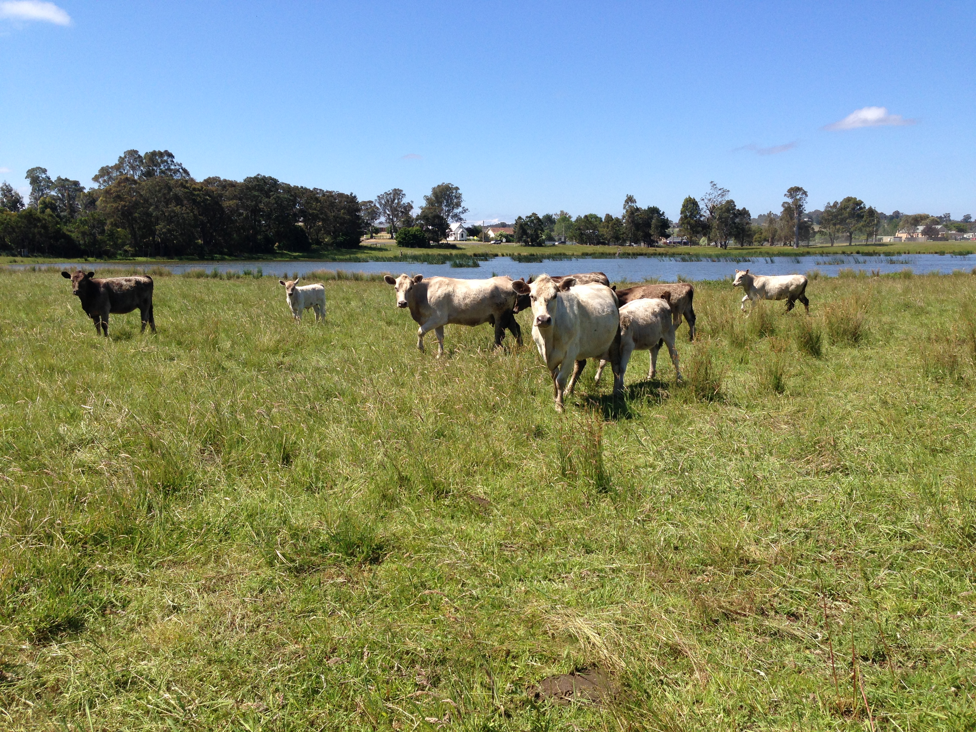
Swan Reach - commenced spring 2016
Low nutrient site occupied by Parramatta Grass.
Using combinations of nutrients, rotational grazing and re-sowing to change composition and improve stocking rates.
Representative of local soils
pastures.
(Refer to handout for design)

Slide 18
October 2016

Slide 19
October 2016

Slide 20
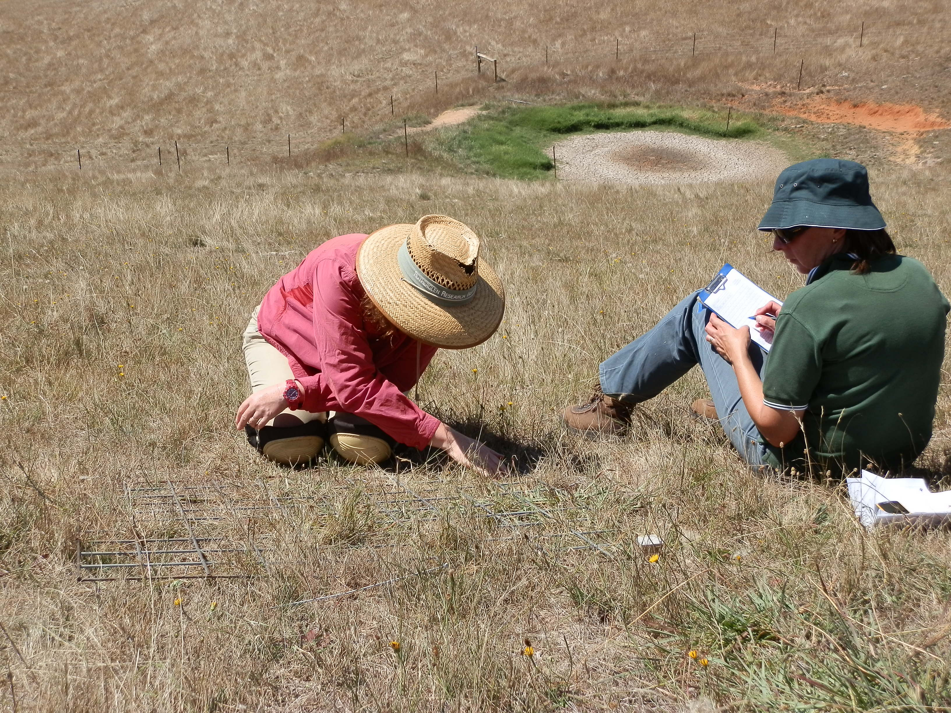
Tambo Valley - commenced spring 2016
Two demonstration sites, one at Connors Hill (low fertility) the other at Reedy Flat (higher fertility).
Both sites native pasture dominant.
Using strategic grazing over
summer to improve stocking
rates and pasture composition.
(Refer to handout for design.)
Image shows assessments at Reedy Flat, high
fertility site – February 2017.

Slide 21
October 2016

Slide 22
October 2016

Slide 23
The End

