Slide 1
Summary of Data on Soil Fertility from SRILC in East Gippsland
TopSoils Project
3rd May 2017
Delegate

Slide 2
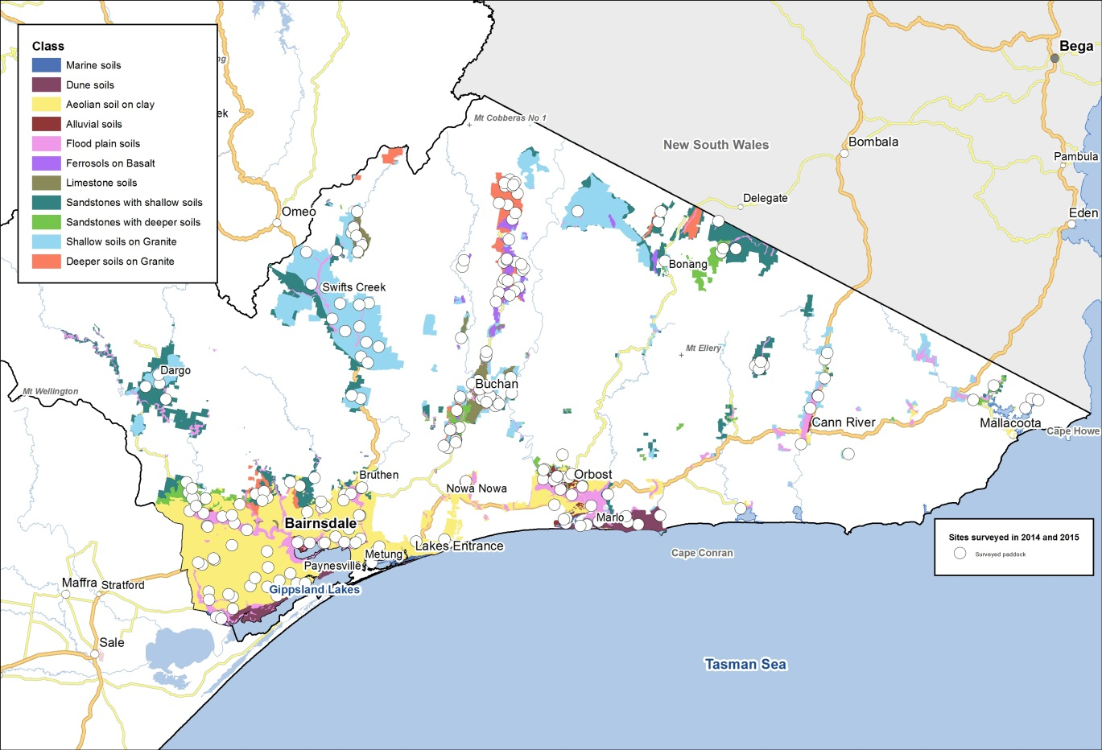
Survey of paddocks with focus on Snow Mountain Basin AMU in the SRILC region

Slide 3
Soil reaction
Soil pH (water) range | Acidity Class | Numbers of samples of Topsoils survey | Numbers of samples
4.5 - 5.0 | Very strongly acidic | 0 | 1
5.0 - 5.5 | Strongly acidic | 9 | 10
5.5 - 6.0 | Moderately acidic | 2 | 14
6.0 - 7.0 | Slightly acidic | 1 | 1
Paddocks from the Snowy Mountain Basin AMU that were sampled by TopSoils, were mostly strongly acidic
Paddocks sampled by SRILC were less acidic

Slide 4
Extractable Aluminium
Extr. Al range (mg/kg) | Interpretation | Numbers of samples in Topsoils survey | Numbers of samples
> 50 | Higher rates of lime are needed for Al sensitive species and it is likely that subsurface Al may be phytotoxic to Al sensitive species, such that it may be uneconomic to sow species such as lucerne | 0 | 4
15 - 50 | Higher rates of lime are needed for Al sensitive species and subsurface Al should be checked | 8 | 15
1 - 15 | Low rates of lime are needed for Al sensitive species | 2 | 7
< 1 | Harmless and below detection limit of 1 mg/kg | 2 | 0
SRILC data was converted to mg Al/kg soil
In both datasets, results suggest soluble aluminium will deleteriously affect sensitive species such as lucerne and phalaris in many paddocks

Slide 5
Tests of Soil Aluminium

Slide 6
Soil acidity affects aluminium toxicity

Slide 7
Olsen P
Soil Olsen P range (mg/kg) | Interpretation | Numbers of samples in Topsoils survey | Numbers of samples
> 18 | Adequate for improved pastures grazed for milk, meat and wool production | 0 | 0
15 - 18 | Adequate for improved pastures grazed for meat and wool production | 0 | 1
12 - 15 | Deficient for improved pastures | 1 | 2
10 - 12 | Adequate for native pastures | 3 | 2
< 10 | Deficient for all classes of pasture | 8 | 21
Soils from the Snowy Mountain Basin AMU were mostly deficient in available phosphorus

Slide 8
Soil P tests

Slide 9
Phosphorus Environmental Risk Index in your reports
PERI = Colwell P/ PBI
Critical Value = 2
“As the available P to PBI ratio rises, so to does the probability of the P buffer capacity of the soil being exceeded. Once the critical value (>2) is exceeded the risk of movement of P in the soil increases.” (From Back Paddock Company)
None exceeded the critical value

Slide 10
Colwell K
Colwell K range (mg/kg) | Numbers of samples in TopSoils survey | Numbers of samples
> 180 | 9 | 13
150 -180 | 2 | 1
120 -150 | 1 | 5
100 -120 | 0 | 3
< 100 | 0 | 4
All paddocks from the Snowy Mountain Basin AMU that were sampled in the TopSoils survey, were adequate for available potassium
More of those sampled by SRILC members were deficient in K

Slide 11
Grass Tetany Risk Index in your reports
GTRIs = K as proportion of total base soil cations (cmol/kg basis), assumed to be calculated as follows: Am. Acetate K/(Am. Acetate Ca + Mg + K + Na)
Critical value = 0.07
“The risk of grass tetany increases as magnesium decreases as a proportion of the total soil cations. This is particularly the case where high rates potassium has been applied in late winter or spring. GTRIs is a calculation that takes into account the balance between the soil cations and indicates a higher risk (>0.07) of grass tetany. Where the GTRI exceeds the critical level, advice from a animal nutrition specialist or veterinarian should be sought.” (From Back Paddock Company website)
“Soil analysis usually not a good indicator of grass tetany risk.” (From MLA website)

Slide 12
Sulfur
Interpretation | Numbers of samples in Topsoils survey (CPC S) | Numbers of samples (KCl40)
More than adequate for pastures | 4 | 2
Adequate for pastures | 4 | 3
Deficient for pastures | 4 | 21
Most paddocks sampled in the TopSoils survey were adequate in available sulfur
In contrast, most paddocks sampled by SRILC members were deficient

Slide 13
Trace elements
Critical values for trace element tests are poorly defined
Focused on Boron given previous research suggests boron deficiency could be affecting clover in pastures in East Gippsland. But, molybdenum could also be affecting clover in this region
Boron:
  Most paddocks sampled in the TopSoils survey were deficient in available boron
  Similarly, all paddocks sampled by SRILC members were deficient
Interpretation for Boron | Numbers of samples in Topsoils survey | Numbers of samples
Above critical value (1 mg/kg) | 4 | 0
At or below critical value | 8 | 26

Slide 14
General impressions
Many paddocks had low soil P fertility and were strongly acidic but there are curious differences in K and S fertility between the TopSoils survey data and the data from SRILC members. Why the contrast?
Soil Test Lab? Different soil types? Different parts of the Snowy Mountain Basin? Different selection focus?
  Both are NATA and ASPAC accredited for key soil tests, e.g. pH and Olsen P
  Soil organic carbon content: SRILC < TopSoils
  Texture: SRILC dominated by clays, TopSoils by lighter textures
  Paddock selection: random in TopSoils, SRILC members…..?

