Slide 1
Summary of Survey of Soil Fertility for SRILC in East Gippsland
TopSoils Project
8th March 2017
Bendoc

Slide 2
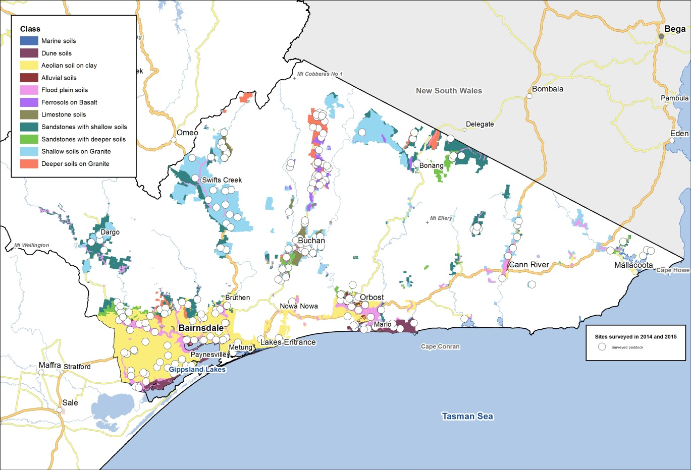
Survey of paddocks

Slide 3
Soil reaction
Soil pH (water) range | Acidity Class | Numbers of samples
4.5 - 5.0 | Very strongly acidic | 0
5.0 - 5.5 | Strongly acidic | 9
5.5 - 6.0 | Moderately acidic | 2
6.0 - 7.0 | Slightly acidic | 1
Soils from the Snowy Mountain Basin AMU are mostly strongly acidic

Slide 4
Extractable Aluminium
Extr Al range (mg/kg) | Interpretation | Numbers of samples
> 50 | Higher rates of lime are needed for Al sensitive species and it is likely that subsurface Al may be phytotoxic to Al sensitive species, such that it may be uneconomic to sow species such as lucerne | 0
15 - 50 | Higher rates of lime are needed for Al sensitive species and subsurface Al should be checked | 8
1 - 15 | Low rates of lime are needed for Al sensitive species | 2
< 1 | Harmless and below detection limit of 1 mg/kg | 2
Soils from the Snowy Mountain Basin AMU generally have results that suggest soluble aluminium will deleteriously affect sensitive species such as lucerne and phalaris in many paddocks
Two paddocks had 44 and 46 mg/kg extractable aluminium. These are too close to the critical value of 50 mg/kg. They may have undesirably high extractable Al in the subsurface soil, i.e. 10-20 cm depth.

Slide 5
Olsen P
Soil Olsen P range (mg/kg) | Interpretation | Numbers of samples
> 18 | Adequate for improved pastures grazed for milk, meat and wool production | 0
15 - 18 | Adequate for improved pastures grazed for meat and wool production | 0
12 - 15 | Deficient for improved pastures | 1
10 - 12 | Adequate for native pastures | 3
< 10 | Deficient for all classes of pasture | 8
Soils from the Snowy Mountain Basin AMU are mostly deficient in available phosphorus for native and improved pastures

Slide 6
Colwell K
Colwell K range (mg/kg) | Numbers of samples
> 180 | 9
150 -180 | 2
120 -150 | 1
100 -120 | 0
< 100 | 0
All samples from the Snowy Mountain Basin AMU were adequate for available potassium

Slide 7
CPC S
Soil CPC S range (mg/kg) | Interpretation | Numbers of samples
> 6 | More than adequate for pastures | 4
4 - 6 | Adequate for pastures | 4
< 4 | Deficient for pastures | 4
Soils from the Snowy Mountain Basin AMU are mostly adequate in available sulfur for pastures

Slide 8
General impressions to date
Many paddocks had low soil P fertility and were strongly acidic
Extension on managing ground cover/pasture production should consider the need to address soil acidity and low soil P fertility

